Slide 1
New Products of AMOTECH
Nov. 2003
AMOTECH Co.
www.amotech.co.kr

Slide 2
Purpose of New Products
AMOTECH’S new products line-up of varistors, ranging from ultra low cap single type to array which has EMI filter effect with various capacitance value, can offer total solutions for ESD/ EMI protection in mobile phone.
Single type : 0402 size
Array type : 2-Array, 0405 (2 of 0402)
4-Array, 0508 (4 of 0402)
0405 (4 of 0201)
8-Array, 0508 (8 of 0201)
Low Capacitance Series (3 pF ~ 100 pF)
Ultra low Capacitance ( 0.8 pF )
Effectiveness in ESD/ EMI Protection
For effective design
For high data trans. rate
For EMI sensitive ICs
For sensitive Signal intensity
ESD Filter Series with EMI filter effect.
Feed-thru varistor
Ultra low Capacitance ( 0.8 pF )

Slide 3

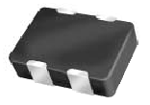
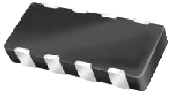
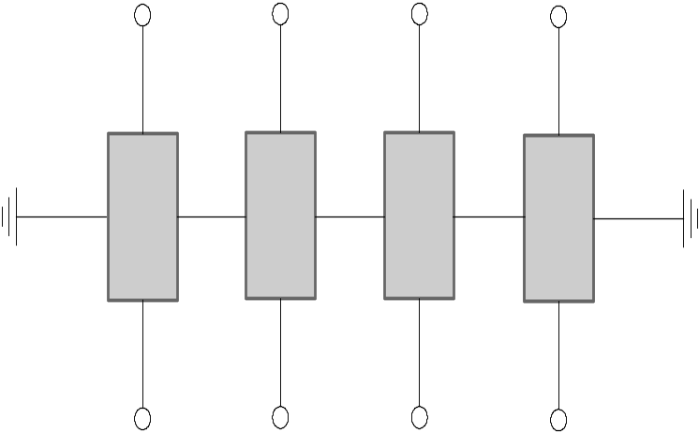
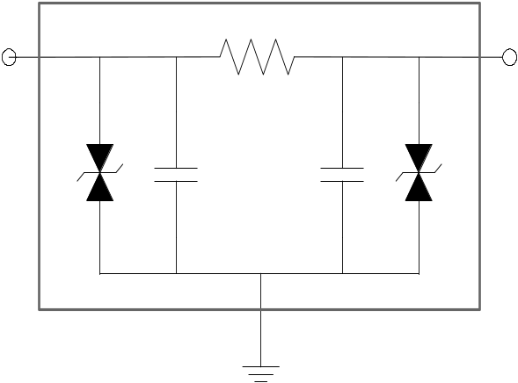
AMOTECH ESD/EMI Components
AMOTECH in the Market
ESD | Single | 2-elements | 4-elements | 8-elements
ESD + EMI
0402
ULCV(0.8 pF)
0405
0508
0405
New
0508
New
New
0508
0508
New
New

Slide 4
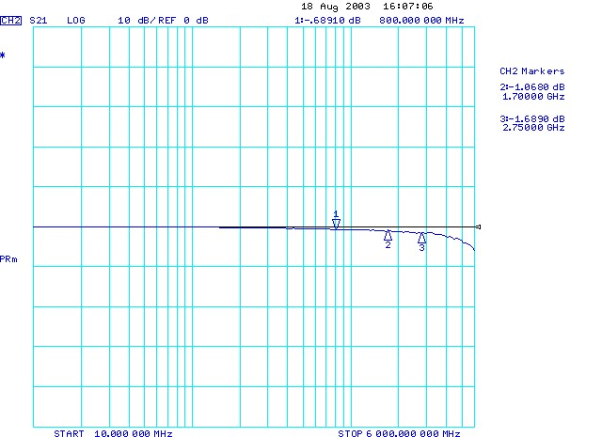
Spec. of new products
Ultra Low Cp Varistor
1. Attenuation property of ULCV
Without ULC Varistor
Frequency | Attenuation
0.8 GHz | -0.66 dB
1.7 GHz | -0.92 dB
2.75 GHz | -1.42 dB
800MHz
1.7 GHz
2.75 GHz
With ULC Varistor
Frequency | Attenuation
0.8 GHz | -0.69 dB
1.7 GHz | -1.06 dB
2.75 GHz | -1.69 dB

Slide 5
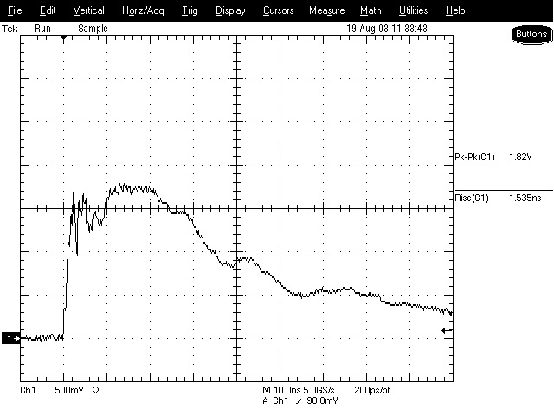
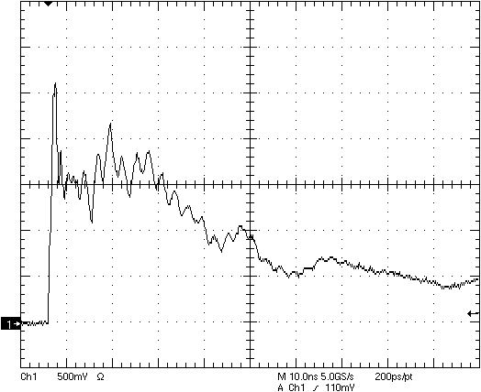
Spec. of new products
Ultra Low Cp Varistor
2. ESD Protection Effect
Without ULC Varistor
With ULC Varistor

Slide 6
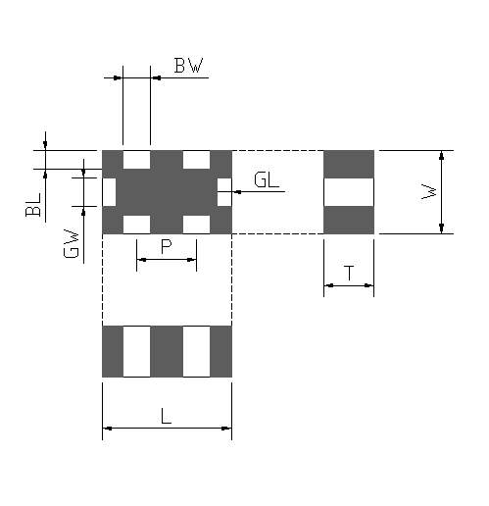
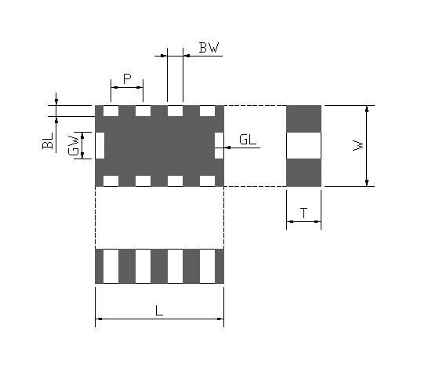
Spec. of new products
4 & 8-element Varistor
1. Dimension
① 4-elements of 0201 size
② 8-elements of 0201 size
Class | L | W | T | P | BW | BL | GW | GL
① | 1.40±0.15 | 0.90±0.15 | 0.55 (max 0.70) | 0.65±0.05 | 0.30±0.05 | 0.20±0.10 | 0.30±0.05 | 0.15±0.10
② | 2.05±0.20 | 1.25±0.20 | 0.55 (max 1.00) | 0.51±0.05 | 0.25±0.05 | 0.18±0.10 | 0.43±0.05 | 0.15±0.10

Slide 7
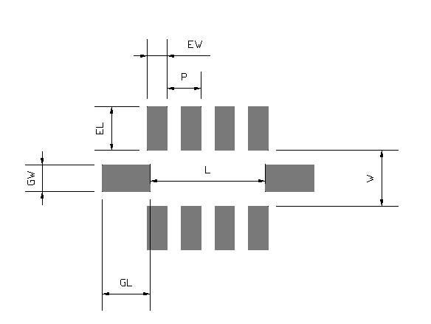
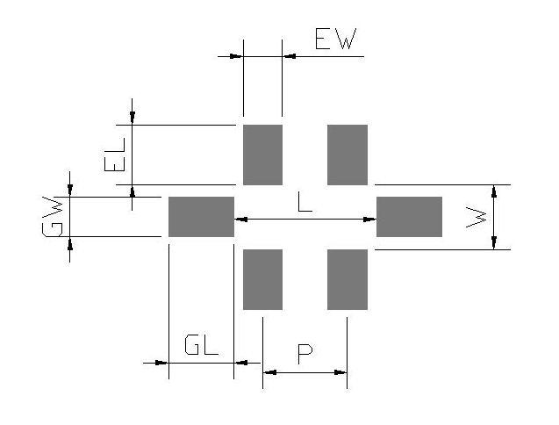
Spec. of new products
4 & 8-element Varistor
2. Recommended Land Pattern
① 4-elements of 0201 size
② 8-elements of 0201 size
 | L | W | P | EW | EL | GW | GL
① | 1.10 | 0.50 | 0.65 | 0.30 | 0.46 | 0.30 | 0.70
② | 1.74 | 0.84 | 0.51 | 0.30 | 0.66 | 0.40 | 0.73

Slide 8
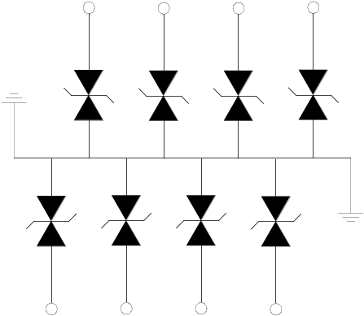
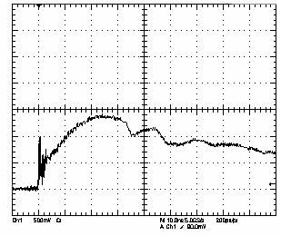
Spec. of new products
4 & 8-element Varistor
3. Equivalent Circuit & ESD protection effect
① 4-elements of 0201 size
② 8-elements of 0201 size
③ ESD Protection Effect

Slide 9
Spec. of new products
Specification of New Varistor
4. Electrical Properties of New Varistor
Item | Model | V_{DC} | V_{N} | V_{C} | I_{C} | I_{MAX} | W_{MAX} | Cap |  | IR
 |  |  |  |  |  |  |  | Max | Typ
Ultra Low Cap Varistor | AVLC 18S 02 001 | 18 | 60~80 | 200 | 1.0 | 0.8 | 0.005 | 1 | 0.8 | 10
4-elements varistor (0405 Size) | AVSC 18S 04 F 010 | 18 | 22 | 45 | 1.0 | 5 | 0.005 | 10 | 8 | 10
 | AVSC 14S 04 F 025 | 14 | 18 | 40 | 1.0 | 5 | 0.005 |  | 25 | 10
 | AVSC 5S 04 F 050 | 5.5 | 8 | 25 | 1.0 | 10 | 0.03 |  | 50 | 10
8-elements varistor (0508 Size) | AVSC 18S 05 E 010 | 18 | 22 | 45 | 1.0 | 5 | 0.005 | 10 | 8 | 10
 | AVSC 14S 05 E 025 | 14 | 18 | 40 | 1.0 | 5 | 0.005 |  | 25 | 10
 | AVSC 5S 05 E 050 | 5.5 | 8 | 25 | 1.0 | 10 | 0.03 |  | 50 | 10

Slide 10
Spec. of new products
Feed-thru Varistor
1. Dimension & Recommended Land Pattern
Class | L | W | T | P | BW | BL | GW | GL
size | 2.05±0.20 | 1.25±0.20 | 0.55 (max 1.00) | 0.51±0.05 | 0.25±0.05 | 0.18±0.10 | 0.43±0.05 | 0.15±0.10
 | L | W | T | P | EW | EL | GW | GL
Land pattern | 1.74 | 0.84 | - | 0.51 | 0.30 | 0.66 | 0.40 | 0.73

Slide 11
Spec. of new products
Feed-thru Varistor
2. Equivalent Circuit
of single component
of 4-elements array

Slide 12
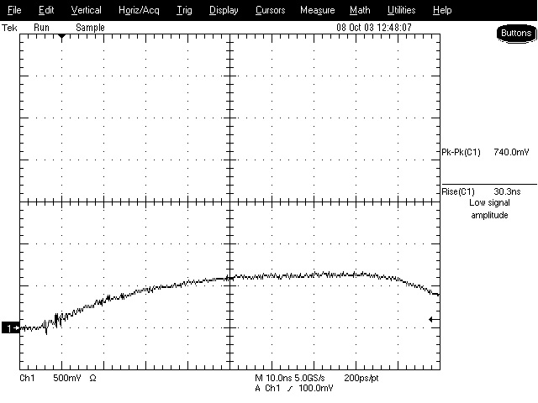
Spec. of new products
Feed-thru Varistor
3. ESD Protection Effect
Without Feed-thru Varistor
With Feed-thru Varistor

Slide 13
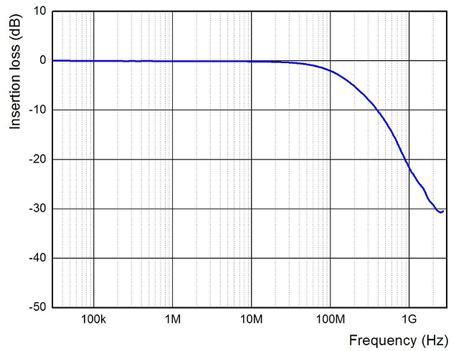
Spec. of new products
Feed-thru Varistor
4. EMI Filtering Effect

Slide 14
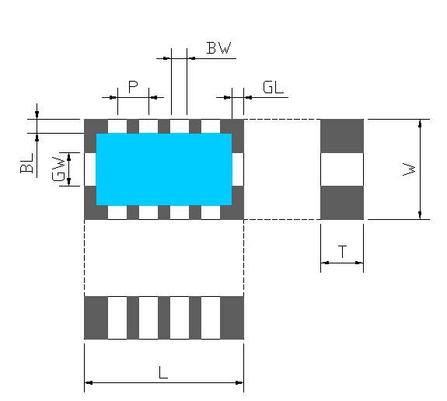
Spec. of new products
4-element ESD Filter
1. Dimension & Recommended Land Pattern
Class | L | W | T | P | BW | BL | GW | GL
size | 2.05±0.20 | 1.25±0.20 | 0.55 (max 1.00) | 0.40±0.05 | 0.25±0.05 | 0.18±0.10 | 0.43±0.05 | 0.15±0.10
 | L | W | T | P | EW | EL | GW | GL
Land pattern | 1.74 | 0.84 | - | 0.40 | 0.25 | 0.66 | 0.40 | 0.73

Slide 15
Spec. of new products
4-element ESD Filter
2. Equivalent Circuit
of single component
of 4-elements array

Slide 16
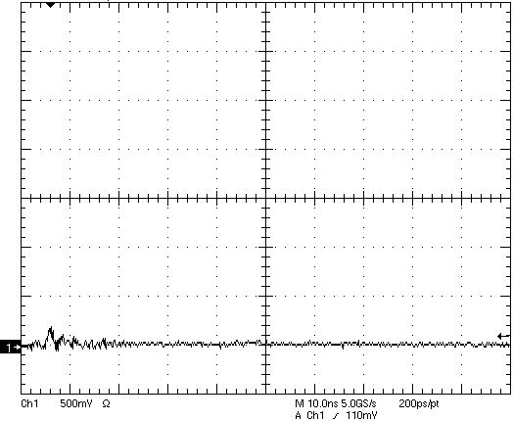
Spec. of new products
4-element ESD Filter
3. ESD Protection Effect
Without ESD Filter
With ESD Filter

Slide 17
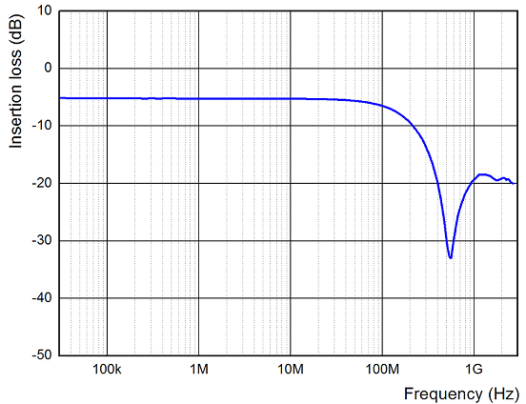
Spec. of new products
4-element ESD Filter
4. EMI Filtering Effect

Slide 18
Spec. of new products
Specification of New EMI Filter
5. Electrical Properties of New Varistor
Item | Model | V_{DC} | V_{N} | V_{C} | I_{C} | I_{MAX} | W_{MAX} | Cap |  | IR | R
 |  |  |  |  |  |  |  | Max | Typ
Feed-thru varistor (0508 size) | AVFC 18S 05 Q 010 | 18 | 22 | 45 | 1.0 | 5 | 0.005 | 10 | 8 | 10
 | AVFC 14S 05 Q 030 | 14 | 18 | 40 | 1.0 | 5 | 0.005 |  | 30 | 10
 | AVFC 5S 05 Q 050 | 5.5 | 8 | 25 | 1.0 | 10 | 0.03 |  | 50 | 10
 | AVFC 5S 05 Q 100 | 5.5 | 8 | 25 | 1.0 | 10 | 0.03 |  | 100 | 10
ESD Filter (0508 size) | AVRC 18S 05 Q 010 100R | 18 | 22 | 45 | 1.0 | 5 | 0.005 | 5 | 4 | 10 | 100Ω
 | AVRC 14S 05 Q 030 100R | 14 | 18 | 40 | 1.0 | 5 | 0.005 |  | 15 | 10 | 100Ω
 | AVRC 5S 05 Q 050 100R | 5.5 | 8 | 25 | 1.0 | 10 | 0.03 |  | 25 | 10 | 100Ω
 | AVRC 5S 05 Q 100 100R | 5.5 | 8 | 25 | 1.0 | 10 | 0.03 |  | 50 | 10 | 100Ω

Slide 19
Stacking Sequence
Spec. of new products
ESD Filter
8-element varistor
Feed-thru varistor

Slide 20
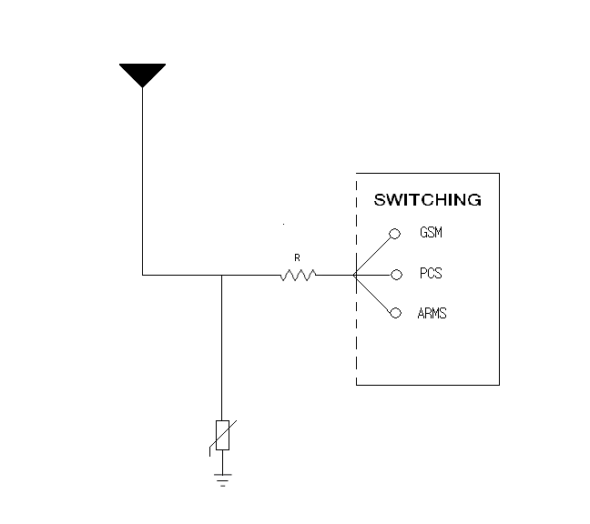
ULCV Application
Antenna switch
1. Antenna is an easy path for ESD .
2. High capacitance value can cause
reduction of signal intensity.
3. Recommended Model
AVLC 18S 02 001
CDMA
PCS
GPS

Slide 21
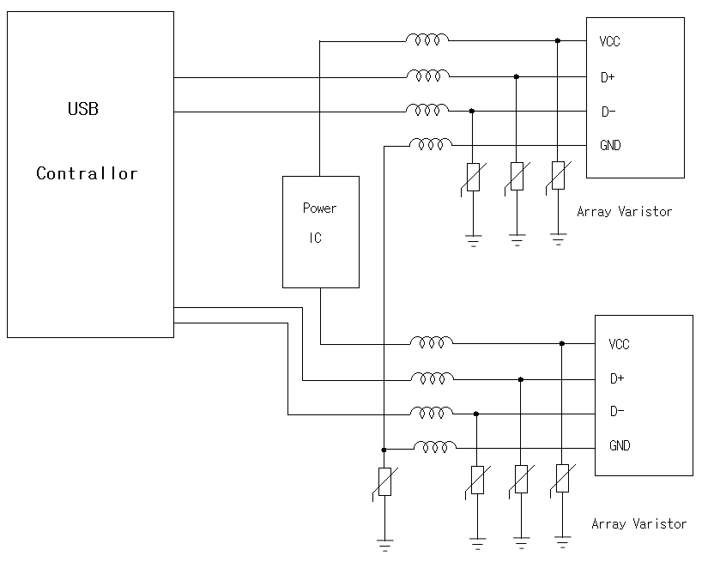
MLV Application
USB Interface
1. Consideration of Cp value
→ USB 1.1 : below 20 pF
→ USB 2.0 : below 4 pF
2. High Cp value can cause distortion of data form or reduction of signal intensity.
3. Recommended Model
AVLC 18S 02 015, AVNC 18S 05Q 015
for USB 1.1
AVLC 18S 02 003, AVNC 18S 05Q 003
for USB 2.0
AVLC 18S 02 001 for USB 2.0

Slide 22
ESD filter Application
LCD Part
LCD Driver IC
1. Main Chip of Cell Phone can generate the
EMI noise.
2. LCD Driver IC has to be protected from ESD.
3. Multi function Protection is needed in Main
chip side and array varistor are
needed in LCD driver IC side.
4. Recommended Model
AVRC 18S 05Q 050 100R for M.C side
AVFC 18S 05Q 050 for M.C side
AVSC 18S 04F 025 for LCD Module
AVNC 18S 05Q 015 for LCD Module
Connector
Main Chip

